Slide 1


KICKSTARTER
FINTECH INDUSTRY
University of Milan
Data Science and Economics
Andrea Ierardi - 960188

Slide 2

Introduction
Kickstarter is an American public benefit corporation that maintains a global Crowdfunding platform focused on creativity.
Based in Brooklyn, New York
Launched in 2009
Introduction

Slide 3
Terminology
Creators: request funding for a project
Backers: support a product voluntarily
Project: the idea of the creators
Funding goal: the amount of money needed to complete the project
Rewards: experiences or products that backers receive from the creator for their support
Introduction

Slide 4
How it works
It is a marketplace where:
The creators launch their project on the platform with a set funding goal.
Describe ideas using images, videos and set rewards to backers.
The rewards can be divided in tiers based on the amount of the support from the backers.
If funding goal is achieved, the backers’ cards are charged with the amount they’ve pledged
The backers will receive the rewards as promised.
Introduction

Slide 5
Categories
Kickstarter is specifically for creative projects in the following categories:
Introduction
Art
Comics
Dance
Design
Film/Video
Food
Games
Journalism
Music
Photography
Technology
Theater

Slide 6
Start a campaign
Create an account: insert some personal information and the password
Describe your project :
key of the success of the project
Creator Book with some tips
Set your rewards : credible goal and suitable rewards
Connect you bank account : to receive the funds.
Introduction

Slide 7











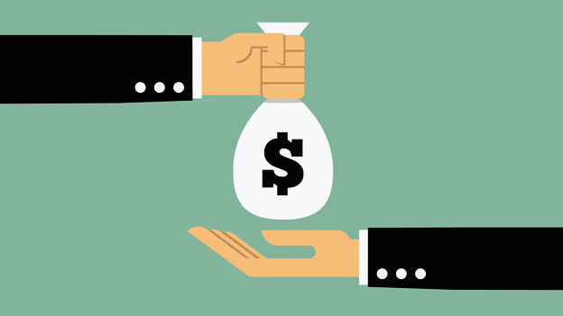

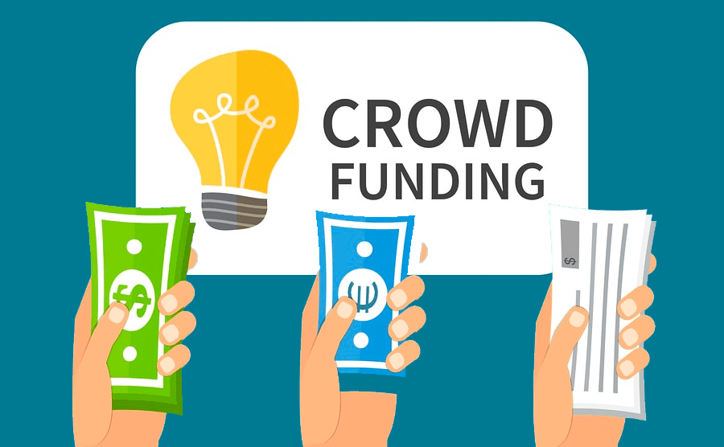
Creators
Rewards
Wait goal
Funding goal
Idea
Launch project
Get money
Send rewards
Find
Wait goal
Support
Pay money
Receive rewards
Backers
This Photo by Unknown Author is licensed under CC BY-NC

Slide 8
Value proposition
It offers a set of primary value propositions:
Accessibility: web-site and app
Risk reduction: no risk in starting a project, free
Performance: platform manage everything
Brand: possibility of creating a community or a brand
Introduction

Slide 9

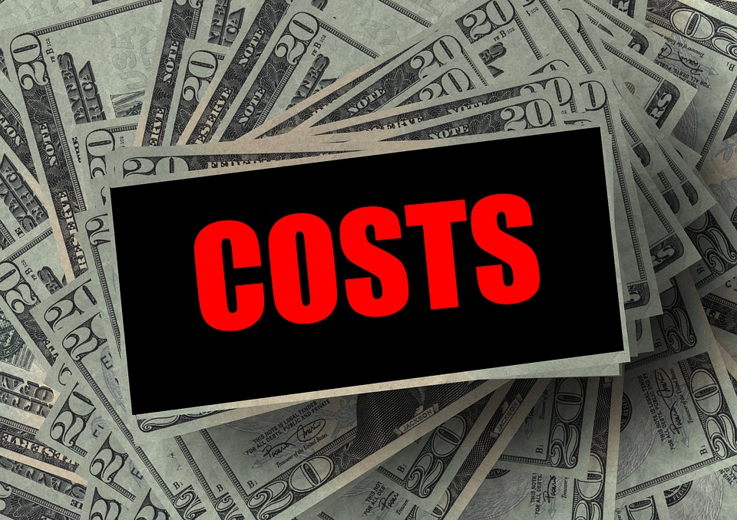
Busines model
Profit
Costs
Cost structure
5% commission fee on the total funds raised
fee for payment processing 3%-5%
Areas of customer support
Administration
Employers
All fixed cost

Slide 10
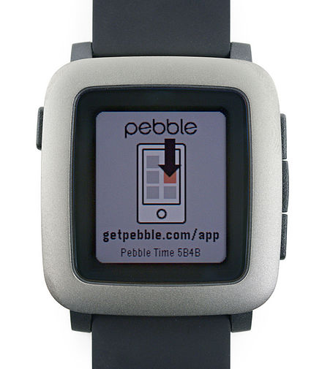
The most funded project
The project is Pebble
$1M in 49 minutes
Raise $20.4M in total
78,741 backers
Pebble helped to lead the current smartwatch trend in the early part of this decade.

Slide 11
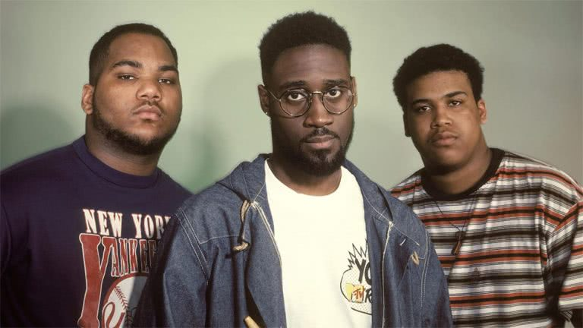

De La Soul
American hip hop group get his project funded:
“Kickstarter is one of those platforms that gives you space to work with people who know you, love you, and support you.”

Slide 12
Conclusions
Kickstarter’s mission is to help bring creative projects to life. They believe that art and creative expression are essential to a healthy and vibrant society
Kickstarter is growing day by day as the number of projects
The platform started in 2009 and projects collectively raise $5.6 billion now.
500.000 project, the 38% of them have been successful.

Slide 13

Questions?

